Slide 1
En français, si vous plait?
AI-Powered French-English translations using PyTorch’s Transformer model and paper implementation of "Attention is All You Need”

Slide 2
Problem : En francais, si vous plait?
Goal of connecting people through language, and advancing a barrier free society for bilingual speakers
Ensure respect for English and French as the two official languages of Canada and have equality of status, rights, and privileges
Solve the technical language translation problem which costs companies/industries time and money
Notes:
Insert image Offiacl acts of canada languaegs

Slide 3
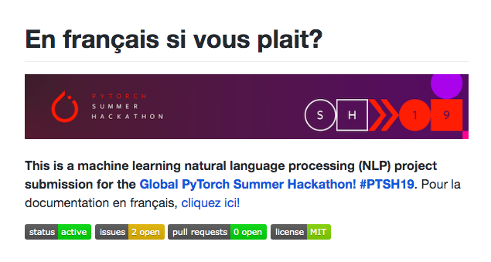
Solution: natural language processing
Sub-field in Artificial Intelligence using machine learning and artificial neural networks
Ability for machines to analyze, understand, and generate human speech
Natural languages
Languages that are native to people
Ex: English, French, or Mandarin
Artificial languages
Languages that computers can operate on
Ex: Python, Java, or C++

Slide 4
SOLUTION: PYTORCH MACHINE LEARNING model INTEGRATION
Pytorch
Open source deep learning research platform that provides maximum flexibility, speed, and provides tensors that live on the GPU accelerating the computation
Facebook Research's Fairseq
Sequence modeling toolkit written in PyTorch
Train custom models for Neural Machine Translation (NMT) - translation, summarization, language modeling, text generation, and etc
Attention Is All You Need
Transformer model with sequence-aligned CNNs
Uses encoder-decoder attention mechanisms in a sequence-to-sequence model that features stacked self attention layers
Transduction model relying on self-attention layers to compute input and output representations where the attention functions maps [query, key-value pairs] to vector outputs of [query, key-value pairs]

Slide 5
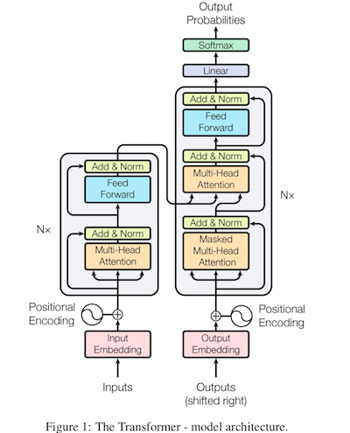
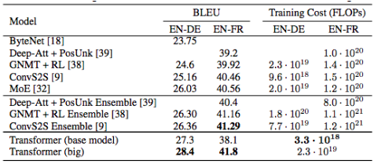
aTTENTION IS ALL YOU NEED MODEL
Convolutional Self-Attention Transformer Model
Statistical machine translation WMT 2014 French-English Benchmark with corpus size 2.3GB and 36 million sentence pairs.
"On the WMT 2014 English-to-French translation task (a widely used benchmark metric for judging the accuracy of machine translation), attention model establishes a BLEU score of 41.8 after training for 3.5 days on eight GPUs, a small fraction of the training costs of the best models from the literature"
Gating to control flow of hidden-units
Multi-Hop Attention Functionality
Self attention layers - where all the keys, values, and queries come from the same input
CNN encoder creates a vector for each word to be translated, and CNN decoder translates words while PyTorch computations are being simultaneously made.

Slide 6
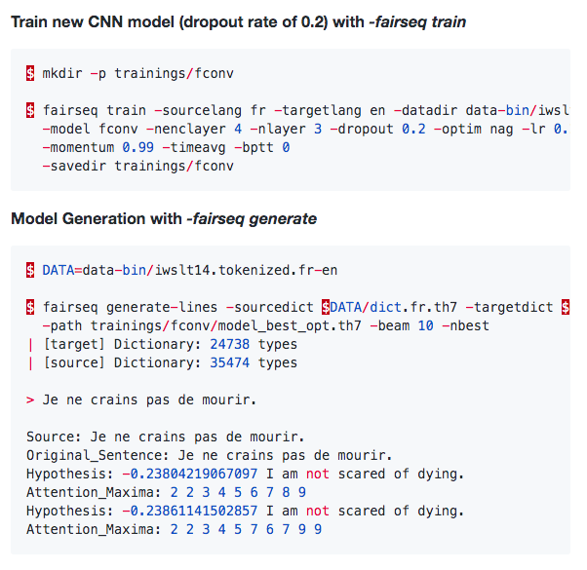
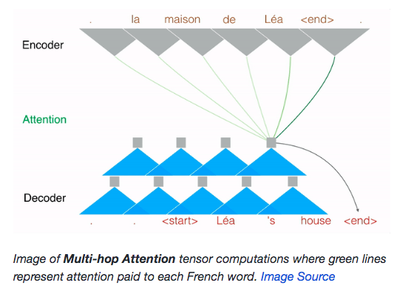
Technical Train the French-English Model
Train new CNN model (dropout rate of 0.2) with -fairseq train
Model Generation with -fairseq generate

Slide 7
APPLICATIONS: Market opportunity
Businesses moving to digital platforms and building their technical stacks
Customer Service
Chatbots taking over repetitive easy-to-automate human jobs
Ex: Bank tellers, cashiers, or sales associates
Legal Industry
NLP used to automate or summarize long and mundane documents
Ex: One legal case has an average of 400-500 pages
Financial Industry
Reduce the manual processing required to retrieve corporate data
Ex: Information from financial reports, press releases, or news articles

Slide 8

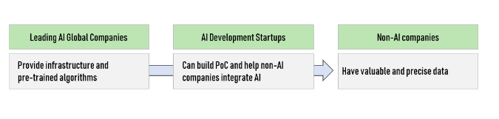
Ai business model
Running costs
Data for building corpus and AI training
Large amounts of raw computing power
Algorithms
AI as a Service (AlaaS)
Artifical Intelligence Solutions as a subscription service
B2B create PoC applications for clients
Revenue Model
Monthly fee
Per-user option allowing company to scale up/down on employee headcount
Fast sales cycle with a proven ROI

Slide 9
REFERENCES
"Attention Is All You Need": https://arxiv.org/abs/1706.03762
Fairseq Technical Documentation: https://fairseq.readthedocs.io/en/latest/models.html#module-fairseq.models.transformer
Canada's Offical Languages Act https://laws-lois.justice.gc.ca/eng/acts/o-3.01/page-1.html
Sequence to Sequence models with PyTorch: https://github.com/MaximumEntropy/Seq2Seq-PyTorch
IBM's PyTorch seq-to-seq model:https://github.com/IBM/pytorch-seq2seq
Translation with Sequence to Sequence Network and Attention: https://pytorch.org/tutorials/intermediate/seq2seq_translation_tutorial.html#sphx-glr-intermediate-seq2seq-translation-tutorial-py
"Convolutional Sequence to Sequence Learning": https://arxiv.org/abs/1705.03122
Data processing scripts: https://www.dagshub.com/Guy/fairseq/src/67af40c9cca0241d797be13ae557d59c3732b409/data

